Slide 1


Gun Violence
PRESENTED BY: Sarah, Hunter, Jack, Deep
GO GITTERS

Slide 2

Why gun violence?
We decided to choose a topic that affected most, if not all, Americans in one form or another. Gun violence is a major issue in the united states and we wanted to get a better understanding of the statistics. There seems to be a lot of misinformation related to gun deaths and we wanted to gather as much data to get a better picture. We want to look at the number of deaths, mass shootings, school shootings and underlying socio-economic factors.

Slide 3
Gun violence QUESTIONS
Have mass shootings increased or decrease over time?
Have school shootings increased or decreased over time?
What accounts for the most gun related deaths in America?
Do certain socio-economic factors play into gun violence?

Slide 4
Predicted outcomes
We believe gun related deaths have a more complex solution than “gun control”
The statistics we are presented in the media only tell part of the story

Slide 5
Brief summation
The statistics on gun violence show that nearly 2/3 of all gun related deaths are attributed to suicide
When gun violence is discussed and debated, this figure is almost never mentioned
It is important to factor in population when looking at the overall number of deaths
Mental health seems to be the biggest factor in gun related deaths

Slide 6
Data sources
CENTER FOR DISEASE CONTROL (CDC) (2012-2014)
Mass shooting data from gun violence archive (2014-2018)
School Shooting Data from Kaggle (1990-2013)
GSS Data Explorer
FBI Uniform Crime Report
Us CENSUS
Gun Sales / Manufacturing Data from ATF

Slide 7
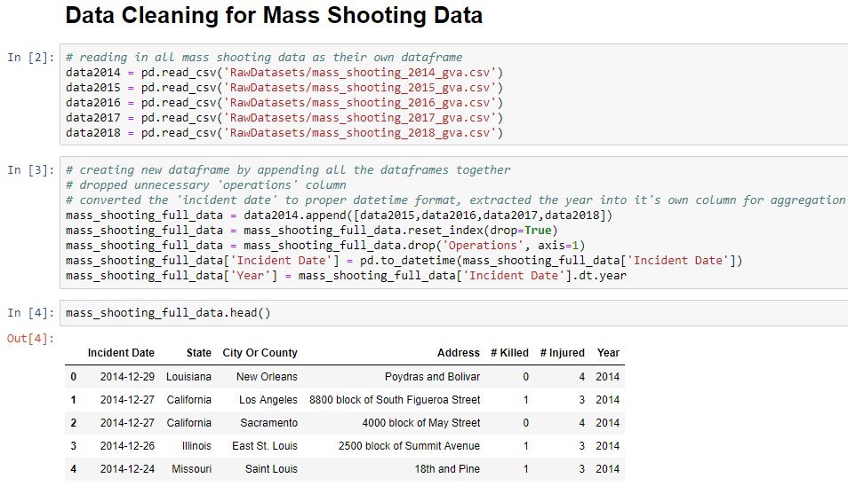
Data Cleaning
Standard Pandas Library
Cleaned raw data to make it more useable and created various dataframes
Used clean data to make subset dataframes based on information we were trying to portray and visualize

Slide 8
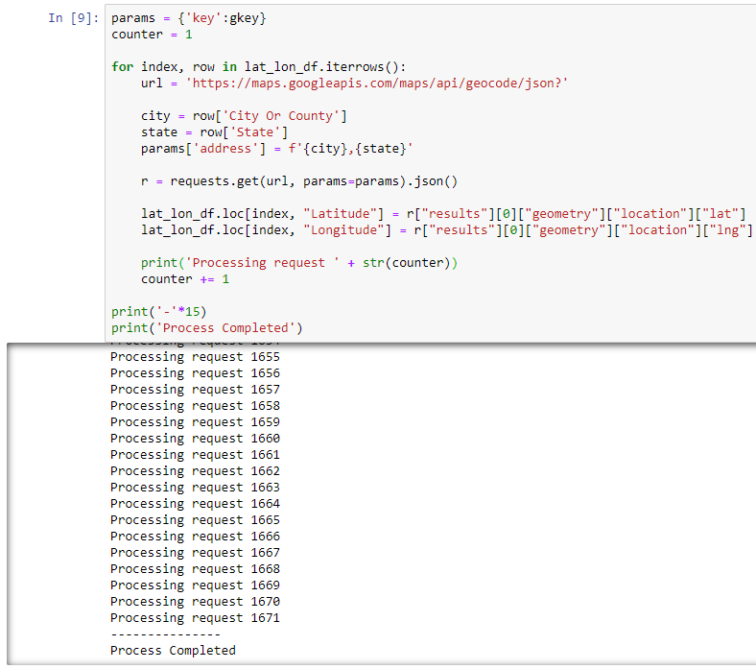
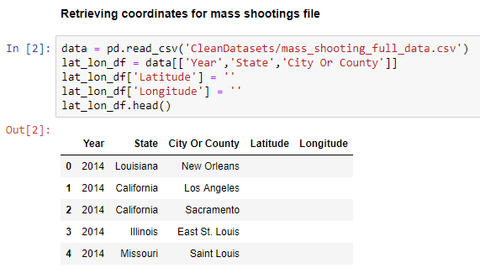
API Code/ Animation
Google geocode api
Gather coordinates of each city where a mass shooting occurred in the data timespan

Slide 9
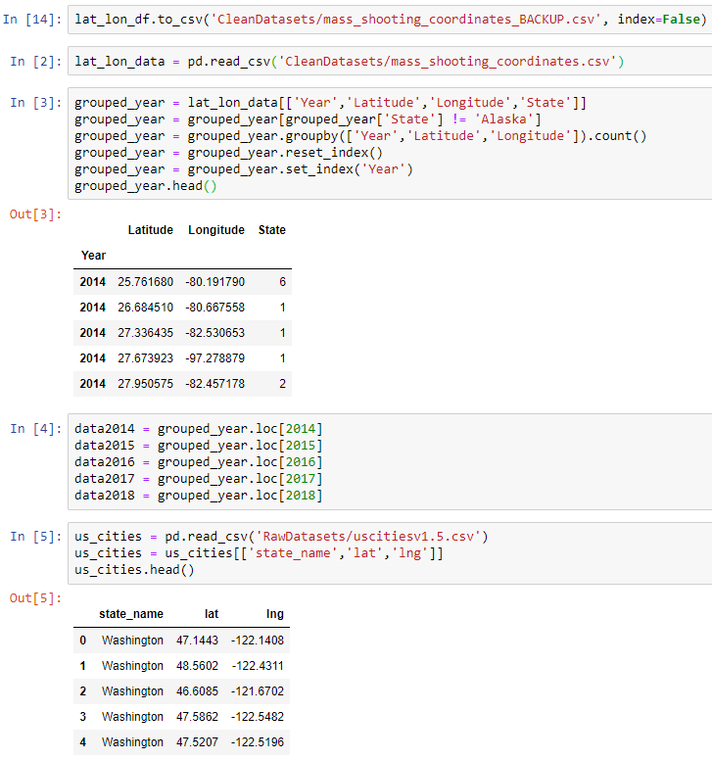
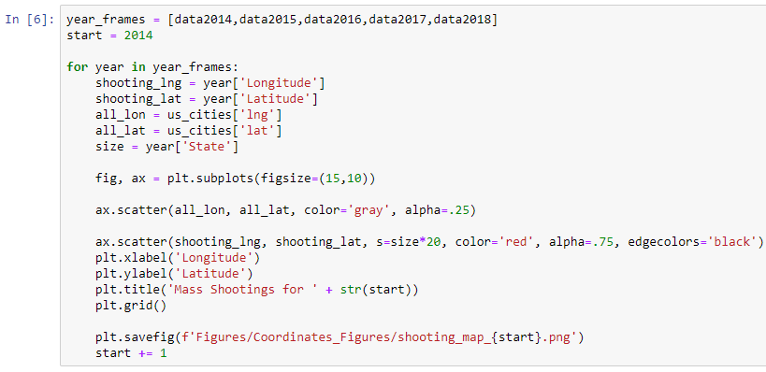
API Code/ Animation
Used a for loop to plot both sets of coordinates, one on top of the other, to create year by year animation

Slide 10

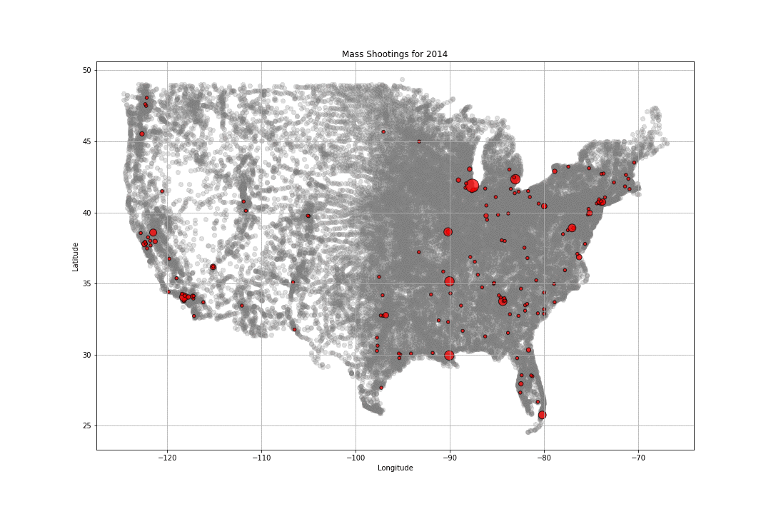

Slide 11
What is considered a Mass shooting?
One strict definition used by the federal government says at least four victims must be killed, excluding the shooter.
Much broader criteria requires at least four victims be injured, though not necessarily killed.
other definitions of mass shootings, which may require that four or more people are killed or exclude certain shootings, such as gang-related and domestic events.

Slide 12
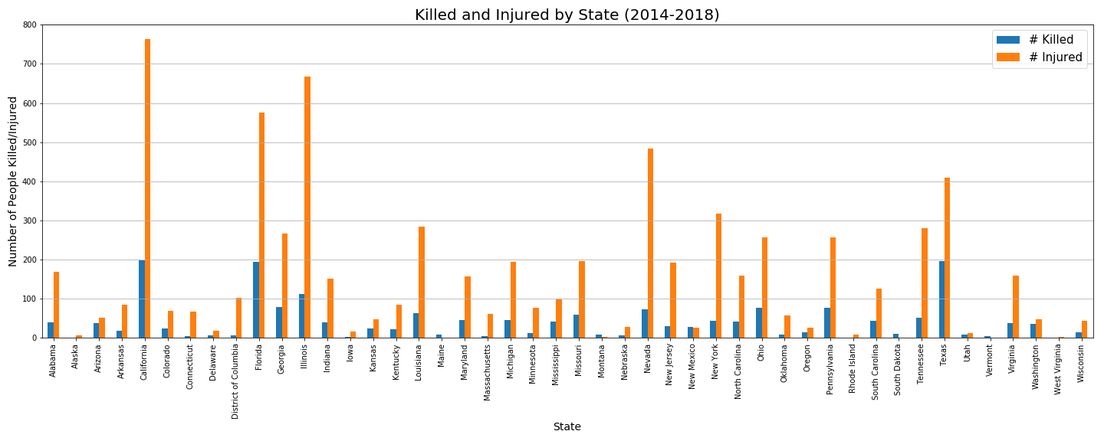
Mass Shootings in each state

Slide 13
Top 5 states
Mass shootings deaths per 100,000
California: 0.58
Population: 39,536,653
Texas: 0.41
Population: 28,304,596
Florida: 0.68
Population: 20,984,400
Illinois: 1.46
Population: 12.802,023
Georgia: 0.78
Population: 10,429,379

Slide 14
Bottom 5 States
Mass shootings deaths per 100,000
Rhode Island: 0.00
Population: 1,059,639
Alaska: 0.00
Population: 739,795
West Virginia: 0.16
Population: 1,815,857
Iowa: 0.12
Population: 3,145,711
Vermont: 0.37
Population: 623,657

Slide 15
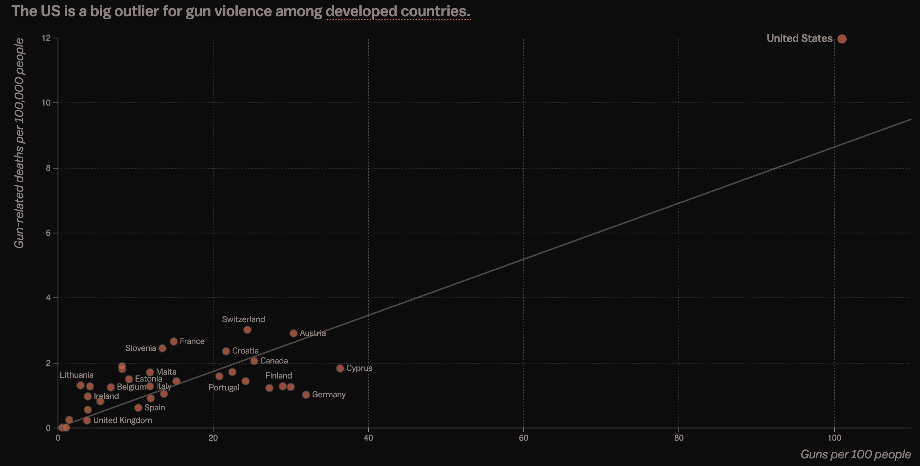
Sources: Gunpolicy.org , United Nations Development Programme

Slide 16
Mass Shootings Deaths
So far in 2019, there have been 72 Mass shootings. 99 people have been killed and 248 wounded
In total, there have been at least 1,997 mass shootings since 2014, with at least 2,281 killed and 8,313 wounded.

Slide 17
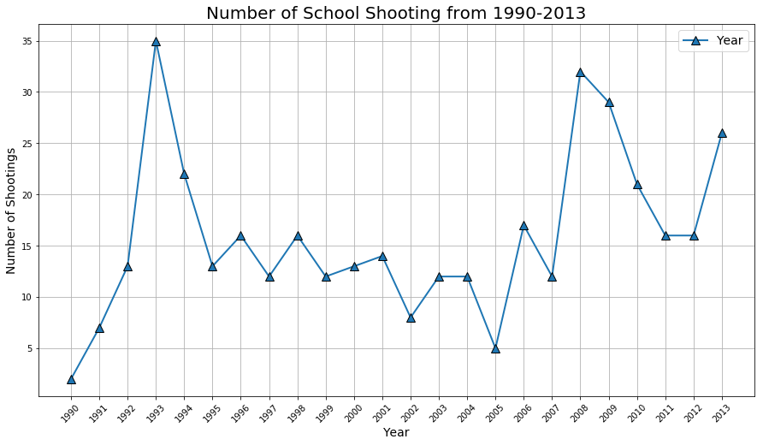
School Shootings

Slide 18
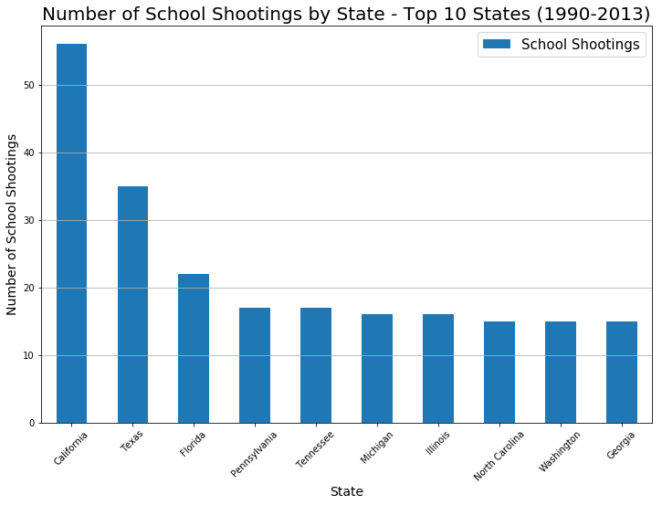
Top 10 States
Looks at total school shootings per state

Slide 19
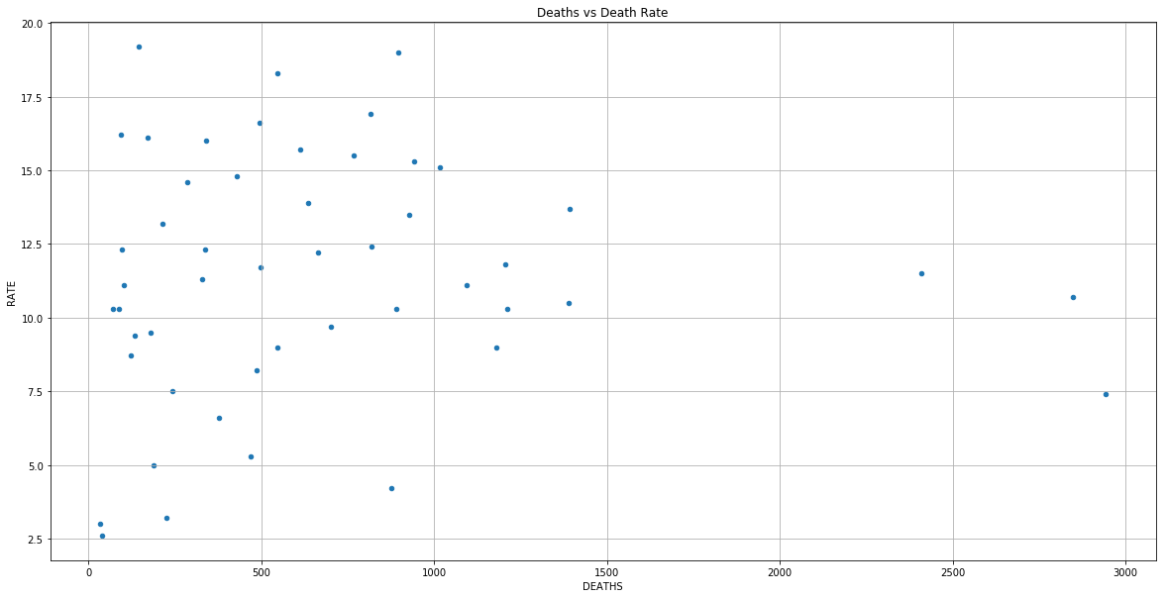
State Breakdown
Looking at the number of deaths per state it is important to look at the death rate along with total number of deaths

Slide 20
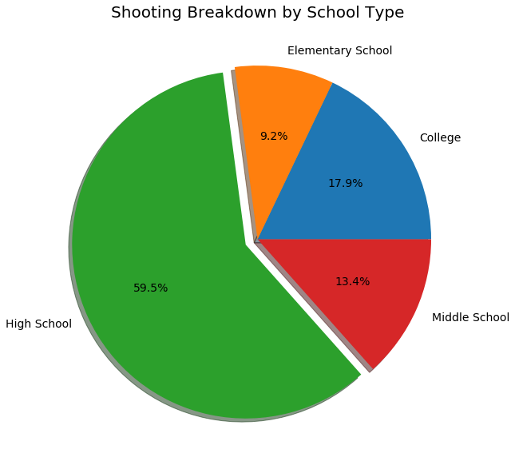
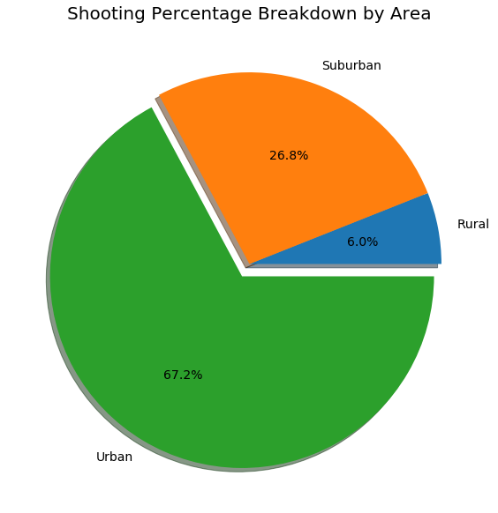
School shootings breakdown

Slide 21
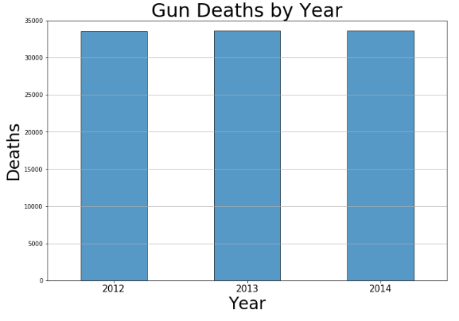
Between 2012 and 2014 there were 100,798 gun deaths in the US
Within this time frame, the death toll remained consistent with around 33,000 individuals per year.
Year Deaths
2012 33,563
2013 33,636
2014 33,599

Slide 22
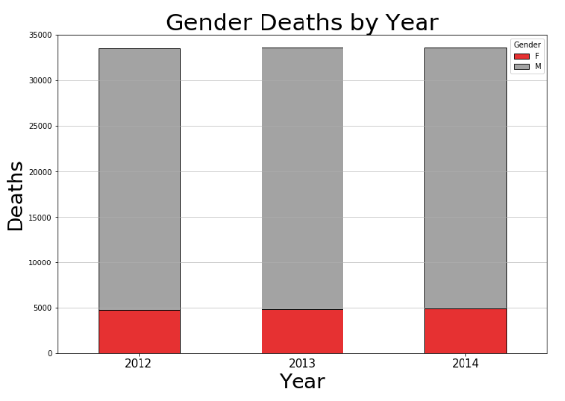

Men Vs. Women
Men are six times more likely to fall victim to gun deaths than women

Slide 23
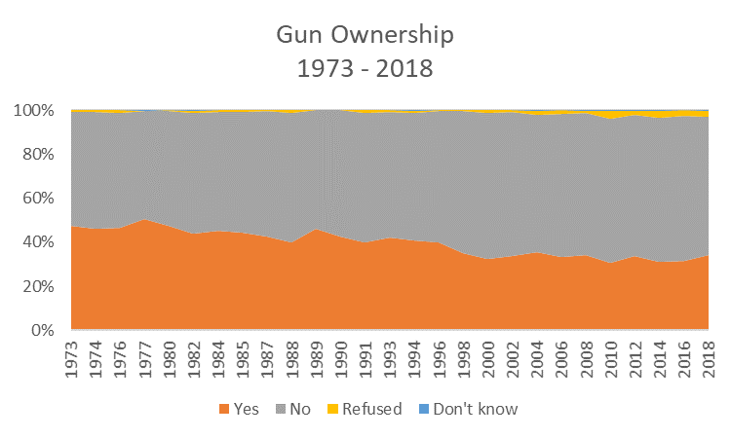
Gun Ownership by Household
Based on a public survey, reported gun ownership per household has seen a downward trend since 1973

Slide 24
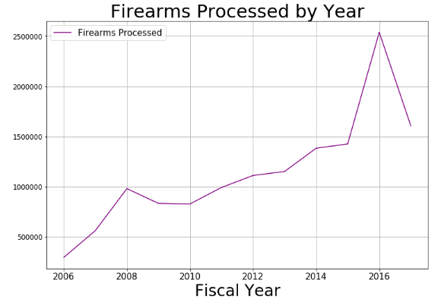

Firearms processed Per Year
While less households report owning guns, data from the ATF shows the number of firearms registrations processed has seen a sharp increase since 2006. Indicating gun owners are stocking up on multiple firearms.
The number of firearm registrations processed was over 2.5 million in 2016

Slide 25
GUN VIOLENCE WITH INTENT
INTENT PLAYS A HUGE FACTOR WHEN LOOKING AT OVERALL GUN DEATHS
WE SAW THAT OVER 60% OF ALL GUN REALTED DEATHS OCCUR DUE TO SUCIDE
WHEREAS HOMICIDE ACCOUNTS FOR ABOUT 35% OF GUN RELATED DEATHS
THIS LARGE DISCREPANCY ALMOST IS NEVER MENTIONED WHEN DISCUSSING GUN VIOLENCE

Slide 26

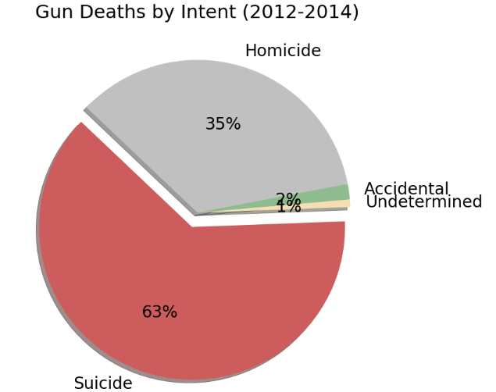
Gun violence with intent
Sadly suicide is the leading cause of gun deaths. Which brings up the question, “Why do so many Americans choose to end their life?”

Slide 27
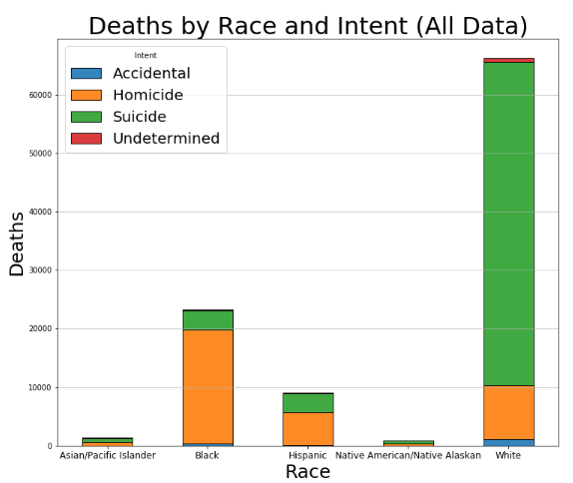
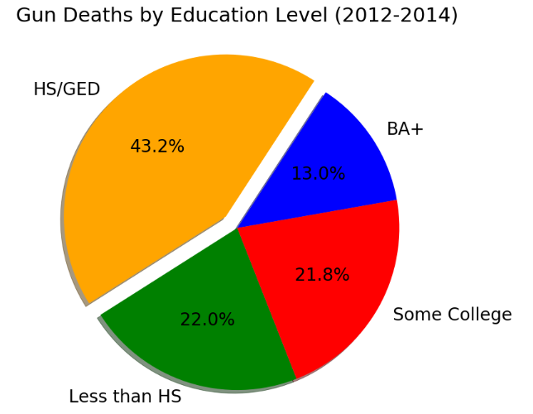
Economic pressures on white men resulting in higher rate of suicide
White individuals are more likely to commit suicide
Lower education is associated with higher economic pressures and lower employment
This data would lead one to believe perhaps mental health is the bigger issue rather than gun violence. Although as suicide is often an impulsive act, it’s possible guns may lead to a more lethal outcome than other means of suicide.

Slide 28
conclusion
Gun violence is an issue that everyone agrees on wanting to prevent and reduce; however, misconceptions could lead to ineffective solutions.
There is a misconception that gun ownership has increased in recent years; however, data shows that households owning guns has declined since the 1970s.
Despite a decrease in households that own guns, the number of firearms has increased significantly, bringing up the question, “If there were not as many firearms in America, could more deaths be prevented?”
Suicide is the leading intent behind gun deaths, which also calls attention to the need for better mental health care and suicide prevention methods.
Gun education is another method that could potentially reduce other types of gun deaths, such as accidents.
Gun violence is a sensitive topic in this country. There are many conflicting opinions; in the end it’s important to remember we all want the same conclusion which is to reduce the number of deaths and keep our loved ones safe.

Slide 29
Final Thoughts
Notes:
Each member can discuss what they found most difficult, what they took away from the project, what they would do with more time and data.

